Slide 1
Library Software
By Jaiminkumar Desai, Vanshika Chopra, Samantha Inneo, Divyamshu Mandadi

Slide 2
The Problem
The Solution
The current space booking system in the library is flawed
Multiple steps before seeing room availability
Other colleges have availability on their homepages
Implement small addition to existing library website
Allow students to see what is available currently as soon as they open the site

Slide 3
Expectations
Update the amount of available group rooms in real time
Implement seamlessly into the existing website
Compatible coding languages
Similar visual style to existing website features
Use LibCal APIs to retrieve booking information

Slide 4
Processes
Project planning
Requirements Elicitation
Basic Planning
Development
Testing
Frequent contact with the client

Slide 5
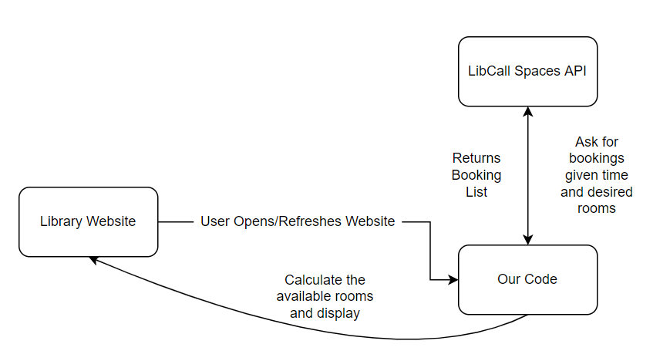

Slide 6
Demo
GitHub: https://github.com/samanthainneo99/SSW540Project

Slide 7
Special Thanks to Romel Espinel from the library, who served as our client and helped us in various ways throughout the development of this project!

